Slide 1
Congestion control
Presentation by
24D25A0507
24D25A0508
24D25A0509
24D25A0510
M3

Slide 2
Introduction
Congestion occurs when network resources are overloaded.
Leads to packet loss,delay &reduced performance.
Congestion control manages traffic to avoid overload.

Slide 3
What is congestion?
Congestion when demands> network capacity.
Causes buffering, queuing delays ,packet drops.
Affects QOS (Quality of service).
Congestion control techniques are used to prevent or reduce congestion.

Slide 4
Effects of congestion control
Improved network stability: prevents overload and keeps the network running smoothly.
Reduced latency and packet loss Ensures data is delivered faster with fewer retransmissions.
Enhanced throughpu: Maximize the volume of data successful transferred in a given time.
Better User Experience: provides faster access to websites, applications, and services.

Slide 5
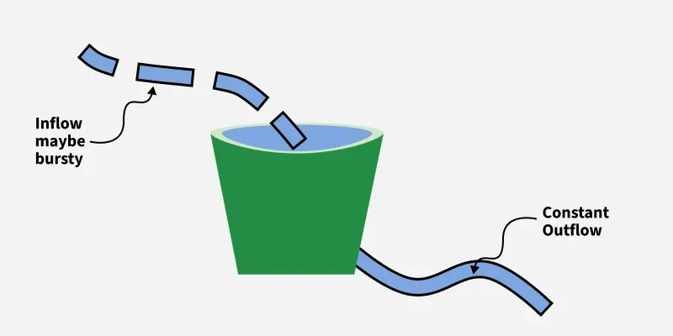
Congestion control Algorithms
Leaky Bucket Algorithm: The leaky bucket algorithm controls the flow of packets by sending them out at a constant, fixed rate, regardless of incoming burst traffic. Packets are placed into a bucket (queue), and if the bucket overflows, excess packets are discarded. This ensures smooth traffic but wastes bandwidth during idle times.

Slide 6
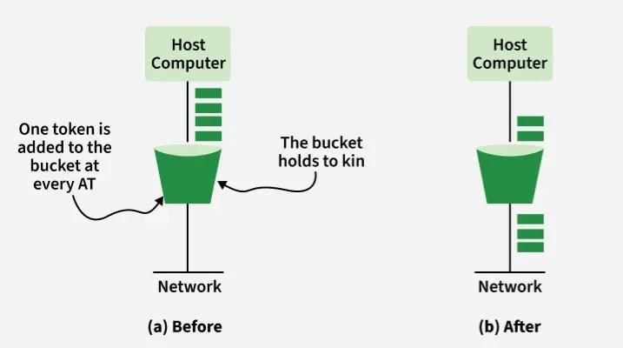
Congestion control Algorithms
2. Token Bucket Algorithm: The token bucket algorithm allows more flexibility by generating tokens at a fixed rate. A packet can only be transmitted if a token is available, and each packet consumes one token. If enough tokens accumulate, burst traffic can be sent quickly, making it better for handling variable traffic patterns without unnecessary drops.

Slide 7
Leaky Bucket vs Token Bucket
Leaky Bucket
Token Bucket
Smooths traffic by enforcing a constant rate.
Uses a leaky bucket to control data transmission.
More rigid, enforces a steady rate.
Limited buffering, excess data is dropped.
Allows for burst traffic by saving tokens.
Uses tokens to control data transmission.
More flexible with bursts.
Data can be buffered until tokens are available.

Slide 8
Advantages of congestion control
Ensures stable and reliable operation of network.
Reduced delays and retransmissions.
Minimizes data loss.
Optimizes resource utilization.
Scales well with growing networks.
Adapts to changing traffic conditions.

Slide 9
Disadvantages of congestion control
Adds complexity to network design.
May introduce overhead in processing.
Can be sensitive to network conditions.
May struggle with resource prioritization in critical scenarios.
Effectiveness depends on modern infrastructure.

Slide 10
Congestion Control in Datagram Subnets
Congestion control in data-gram and subnets: Some congestion Control approaches which can be used in the datagram Subnet (and also in virtual circuit subnets) are given under.
Choke packets
Load shedding
Jitter control

Slide 11
1.CHOKE PACKET:
A choke packet is a packet sent by a node to the. Source to inform it of that congestion had occurred on the network.
Message is sent from congestion node directly to the source station without informing the intermediate routers.
The router will check each newly arriving packet to see if it’s output line is in the warning State.
If it is in the warning State then the router will send back choke packets

Slide 12
2. Load shedding:

